Slide 1

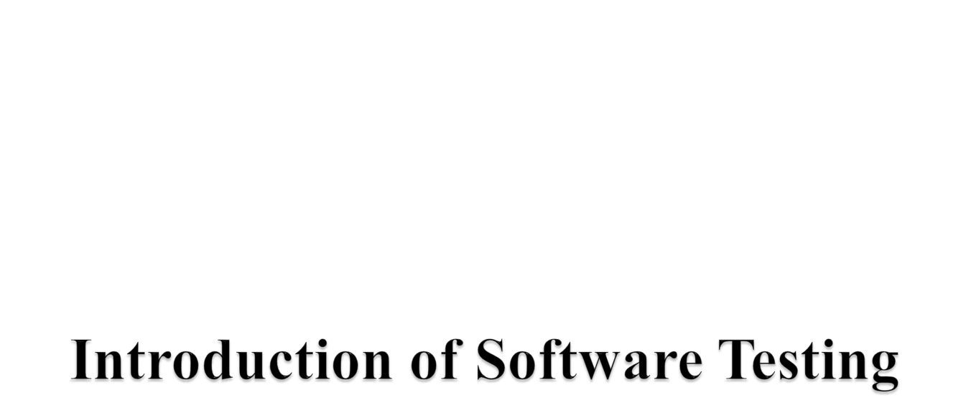

Slide 2
Introduction of Software Testing
Learning Objectives :
Introduction of Software Testing.
Why is Testing necessary?
Participants in Testing
Best Practices in Testing
Skills required for Testing

Slide 3
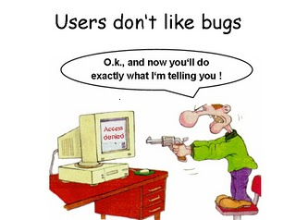
Software Testing

Slide 4
What is Software Testing?
It is not sufficient to demonstrate that the software is doing what it is supposed to do.
It is more important to demonstrate that the software is not doing what it is not supposed to do.

Slide 5
What is Software Testing
Software testing can also be stated as the process of validating and verifying that a software program/application/product:
  works as expected according to the business and technical requirements
  works consistently and predictably
Process of finding defects i.e. variance between Expected results and Actual results.
Process of executing a software program application with intent of finding errors.

Slide 6
Why – What – How - Who
Why to test?
What to test?
How often to test?
Who tests?

Slide 7

Software Testing is necessary to make sure the product or application is defect free, as per customer specifications.
Software Testing identifies faults whose removal increases the software quality and increases the software's reliability.
Testing effort is directly proportional to the complexity of the program.
More complex the program, more the testing effort is required.

Slide 8

Software should be:
  Error Free
  Efficient
  Secured
Software Testing is important as it may cause mission failure, impact on operational performance and unreliable if not done properly

Slide 9
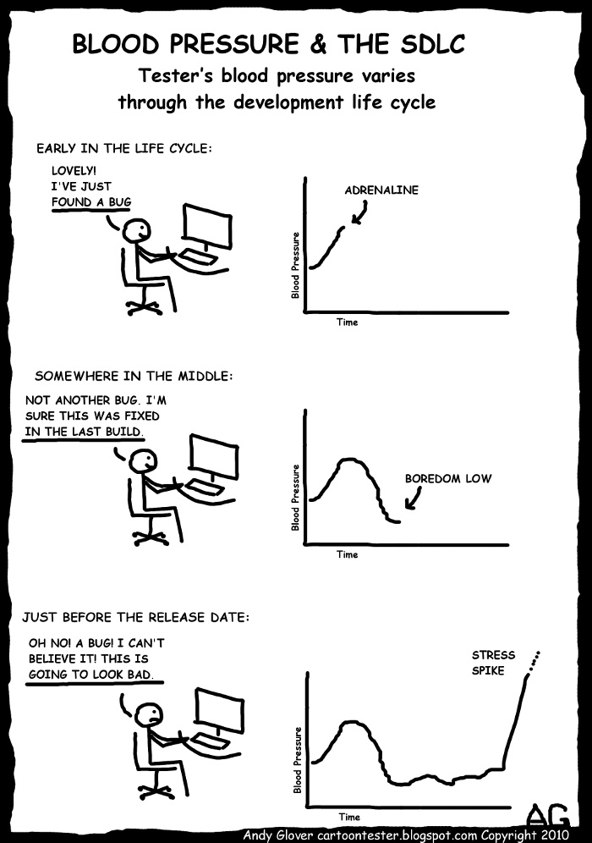
Start Testing-When?

Slide 10
Start Testing - When?
Testing starts right from the requirements phase and continues till the release time.
Objective of starting early:
Requirements related defects caught later in the SDLC result in higher cost to fix the defect.

Slide 11
Stop Testing (Economics of Testing) :
Optimum Point
Optimum Point
Quantity
Cost of Testing
Quantity
Number of defects
Number of defects
Under testing
Over Testing
Under testing
Over Testing
Duration
Duration
Notes:
Under Testing: cust dissatisfaction and over testing: costing increases so avoided

Slide 12
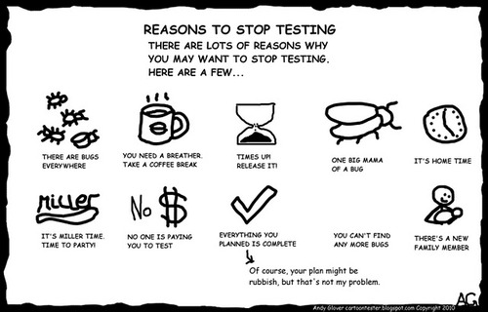
Stop Testing – When?

Slide 13
Stop Testing – When?
Following factors are considered:
Test cases executed with acceptable percentage of defects
Project Deadlines e.g. release deadlines, testing deadlines
Test budget has run out
Coverage of code, functionality or requirements reaches to specific point
Bug rate falls below acceptable level

Slide 14
Participants in Testing
Customer
User
Developer
Tester
Auditor

Slide 15
Common problems in the software development process
Poor Requirements – unclear, incomplete, too general
Unrealistic Schedule – If too much work is crammed in too little time, problems are inevitable
Inadequate testing – No one will know whether or not the program is any good till the customer complains or system crashes.
Features –A request to pile on new features after development is underway; extremely common.
Miscommunications – If developers don’t know what’s needed or customers have erroneous expectations, problems are guaranteed

Slide 16
Best Practices in Testing
Test Planning
Code Testability
Test often
Test early
Measure test costs, coverage, results and effectiveness.
Negative Testing: Needs Kick the wall approach

Slide 17
Skills required for Testing?
Strong desire for quality and attention to detail.
Ability to understand the point of view of the customer
Tact and diplomacy for maintaining the cooperative relationship with developers
Ability to communicate with both technical and non-technical people
Judgment skills are needed to assess high risk areas of an application on which to focus testing efforts when time is limited
‘Test to break’ attitude

Slide 18

Anyone can test software: No particular skill is required.
Testers can test the quality at the end of the project!
Defects found means blaming to the developers.

Slide 19

What are the Skills required for Testing?
What is stop Testing ?
Explain the common problems in software development process .

Slide 20



